Slide 1
chapter 5 resample methods

Slide 2
Resampling methods are an indispensable tool in modern statistics.
They involve repeatedly drawing samples from a training set and refitting a model of interest on each sample in order to obtain additional information about the fitted model.
In this chapter, we discuss two of the most commonly used resampling methods, cross-validation and the bootstrap.

Slide 3
5.1 Cross-Validation
In Chapter 2 we discuss the distinction between the test error rate and the training error rate. Given a data set, the use of a particular statistical learning method is warranted if it results in a low test error. The test error can be easily calculated if a designated test set is available.
The training error rate often is quite different from the test error rate, and in particular the former can dramatically underestimate the latter.

Slide 4
Some methods make a mathematical adjustment to the training error rate in order to estimate the test error rate. Such approaches are discussed in Chapter 6.
In this section, we instead consider a class of methods that estimate the test error rate by holding out a subset of the training observations from the fitting process, and then applying the statistical learning method to those held out observations.

Slide 5
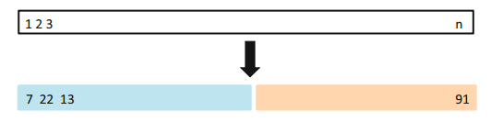
5.1.1 The Validation Set Approach
It involves randomly dividing the available set of observations into two parts, a training set and a validation set or hold-out set.
The model is fit on the training set, and the fitted model is used to predict the responses for the observations in the validation set. The resulting validation set error rate—typically assessed using MSE in the case of a quantitative response—provides an estimate of the test error rate.

Slide 6
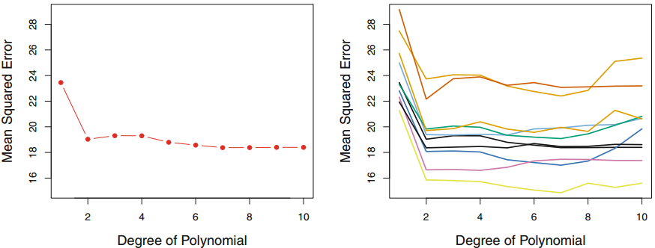

Slide 7
1. As is shown in the right-hand panel of Figure, the validation estimate of the test error rate can be highly variable, depending on precisely which observations are included in the training set and which observations are included in the validation set.
2. Since statistical methods tend to perform worse when trained on fewer observations, this suggests that the validation set error rate may tend to overestimate the test error rate for the model fit on the entire data set.

Slide 8

5.1.2 Leave-One-Out Cross-Validation
Like the validation set approach, LOOCV involves splitting the set of observations into two parts. However, instead of creating two subsets of comparable size, a single observation (x1, y1) is used for the validation set, and the remaining observations {(x2, y2), . . . , (xn, yn)} make up the training set.
Since (x1, y1) was not used in the fitting process, MSE1 =(y1 − y ˆ1)^2 provides an approximately unbiased estimate for the test error. Repeating this approach n times produces n squared errors, MSE1, . . . , MSEn.

Slide 9
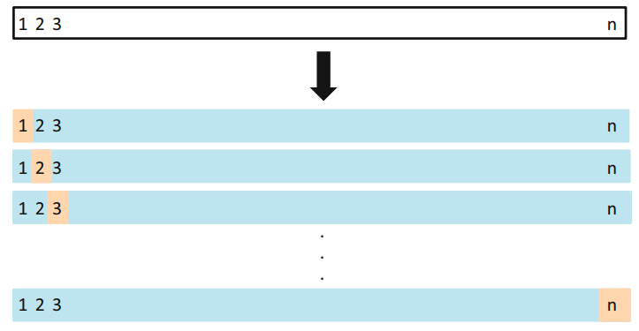

Slide 10
LOOCV’s major advantages
LOOCV has a couple of major advantages over the validation set approach. First, it has far less bias. In LOOCV, we repeatedly fit the statistical learning method using training sets that contain n − 1 observations, almost as many as are in the entire data set Second, in contrast to the validation approach which will yield different results when applied repeatedly due to randomness in the training/validation set splits, performing LOOCV multiple times will always yield the same results: there is no randomness in the training/validation set splits.

Slide 11

LOOCV has the potential to be expensive to implement, since the model has to be fit n times.
With least squares linear or polynomial regression, an amazing shortcut makes the cost of LOOCV the same as that of a single model fit!

Slide 12

5.1.3 k-Fold Cross-Validation
An alternative to LOOCV is k-fold CV. This approach involves randomly dividing the set of observations into k groups, or folds, of approximately equal size.
This procedure is repeated k times; each time, a different group of observations is treated as a validation set. This process results in k estimates of the test error, MSE1, MSE2, . . . , MSEk. The k-fold CV estimate is computed by averaging these values

Slide 13
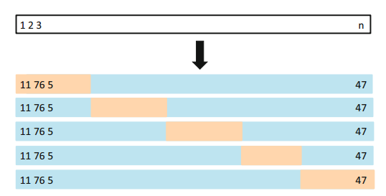

Slide 14
It is not hard to see that LOOCV is a special case of k-fold CV in which kn is set to equal n. In practice, one typically performs k-fold CV using k = 5or k = 10.
What is the advantage of using k = 5 or k = 10 rather than k = n? The most obvious advantage is computational. LOOCV requires fitting the statistical learning method n times.

Slide 15
Our goal to perform cross-validation
When we perform cross-validation, our goal might be to determine how well a given statistical learning procedure can be expected to perform on independent data; in this case, the actual estimate of the test MSE is of interest.
But at other times we are interested only in the location of the minimum point in the estimated test MSE curve. This is because we might be performing cross-validation on a number of statistical learning methods, or on a single method using different levels of flexibility, in order to identify the method that results in the lowest test error.

Slide 16
5.1.4 Bias-Variance Trade-Off for k-Fold Cross-Validation
Putting computational issues aside, a less obvious but potentially more important advantage of k-fold CV is that it often gives more accurate estimates of the test error rate than does LOOCV. This has to do with a bias-variance trade-off.
From the perspective of bias reduction, it is clear that LOOCV is to be preferred to k-fold CV.
It turns out that LOOCV has higher variance than does k-fold CV with k < n.

Slide 17
LOOCV has higher variance than does k-fold CV with k < n
When we perform LOOCV, we are in effect averaging the outputs of n fitted models, each of which is trained on an almost identical set of observations; therefore, these outputs are highly (positively) correlated with each other.
In contrast, when we perform k-fold CV with k < n, we are averaging the outputs of k fitted models that are somewhat less correlated with each other, since the overlap between the training sets in each model is smaller.

Slide 18

5.1.5 Cross-Validation on Classification Problems
In this setting, cross-validation works just as described earlier in this chapter, except that rather than using MSE to quantify test error, we instead use the number of misclassified observations.
For instance, in the classification setting, the LOOCV error rate takes the form

Slide 19
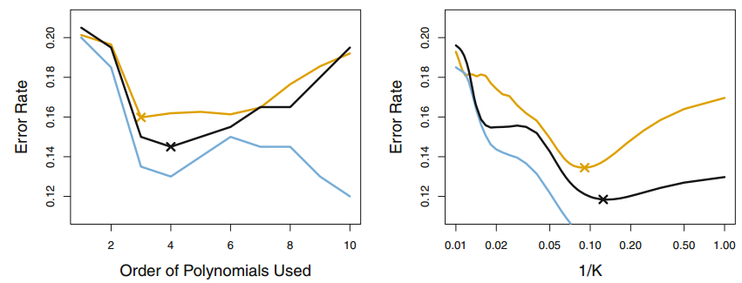

Slide 20
5.2 The Bootstrap
The bootstrap is a widely applicable and extremely powerful statistical tool bootstrap that can be used to quantify the uncertainty associated with a given estimator or statistical learning method. As a simple example, the bootstrap can be used to estimate the standard errors of the coefficients from a linear regression fit.
However, the power of the bootstrap lies in the fact that it can be easily applied to a wide range of statistical learning methods, including some for which a measure of variability is otherwise difficult to obtain and is not automatically output by statistical software.

Slide 21


A toy example
Suppose that we wish to invest a fixed sum of money in two financial assets that yield returns of X and Y
We will invest a fraction α of our money in X, and will invest the remaining 1 − α in Y . Since there is variability associated with the returns on these two assets, we wish to choose α to minimize the total risk, or variance, of our investment.

Slide 22
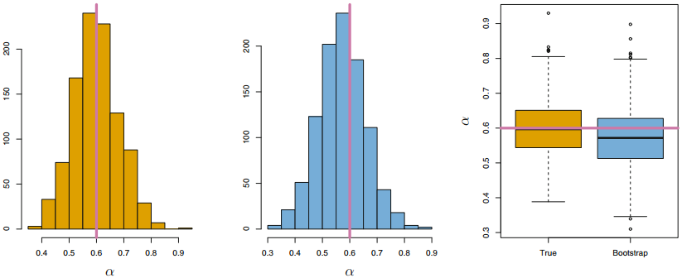

Slide 23
Left: A histogram of the estimates of α obtained by generating 1,000 simulated data sets from the true population.
Center: A histogram of the estimates of α obtained from 1,000 bootstrap samples from a single data set.
Right: The estimates of α displayed in the left and center panels are shown as boxplots. In each panel, the pink line indicates the true value of α.

Slide 24
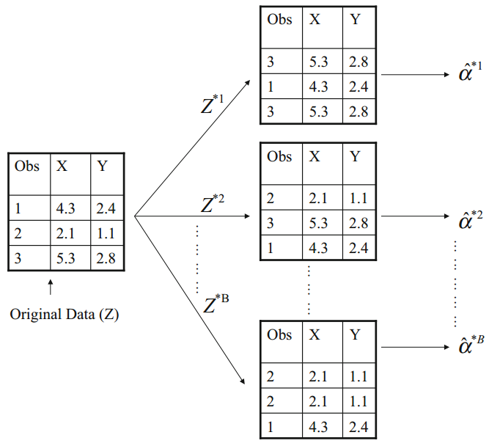

Slide 25
Code : The Validation Set Approach
library (ISLR )
set.seed (1)
attach (Auto)
train = sample (392 ,196)
lm.fit =lm(mpg~horsepower ,data=Auto , subset = train )
mean ((mpg - predict (lm.fit ,Auto))[- train ]^2)
lm.fit2=lm(mpg~poly( horsepower ,2) ,data=Auto , subset =train )
mean ((mpg - predict (lm.fit2 ,Auto ))[- train ]^2)
lm.fit3=lm(mpg~poly( horsepower ,3) ,data=Auto , subset =train )
mean ((mpg - predict (lm.fit3 ,Auto ))[- train ]^2)

Slide 26
Code: Leave-One-Out Cross-Validation
library (ISLR )
attach (Auto)
library (boot)
glm.fit =glm (mpg~horsepower , data= Auto)
cv.err = cv.glm (Auto ,glm.fit, K=392 )
cv.err$delta

Slide 27
Code : k-Fold Cross-Validation
library (ISLR )
attach (Auto)
set.seed (17)
cv.error.10= rep (0 ,10)
for (i in 1:10) {
glm.fit =glm (mpg~poly( horsepower ,i),data=Auto )
cv.error.10[i]= cv.glm (Auto ,glm.fit , K =10) $delta [1]
}
cv.error.10

Slide 28
Code : Estimating the Accuracy of a Statistic of Interest by bootstrap
library (ISLR )
alpha.fn= function (data , index ){
X= data$X [ index ]
Y= data$Y [ index ]
return (( var (Y)-cov (X,Y))/( var (X)+ var (Y) -2* cov (X,Y)))
}
alpha.fn( Portfolio ,1:100)
set.seed (1)
alpha.fn( Portfolio ,sample (100 ,100 , replace =T))
boot(Portfolio , alpha.fn ,R =1000)

Slide 29
Code : Estimating the Accuracy of a Linear Regression Model by bootstrap
library (ISLR )
boot.fn= function(data ,index)
return (coef(lm(mpg~horsepower , data=data , subset = index )))
boot.fn( Auto ,1:392)
set.seed (1)
boot.fn(Auto ,sample (392 ,392 , replace =T))
boot(Auto ,boot.fn ,1000)
summary (lm(mpg~horsepower ,data =Auto))$coef

